Slide 1
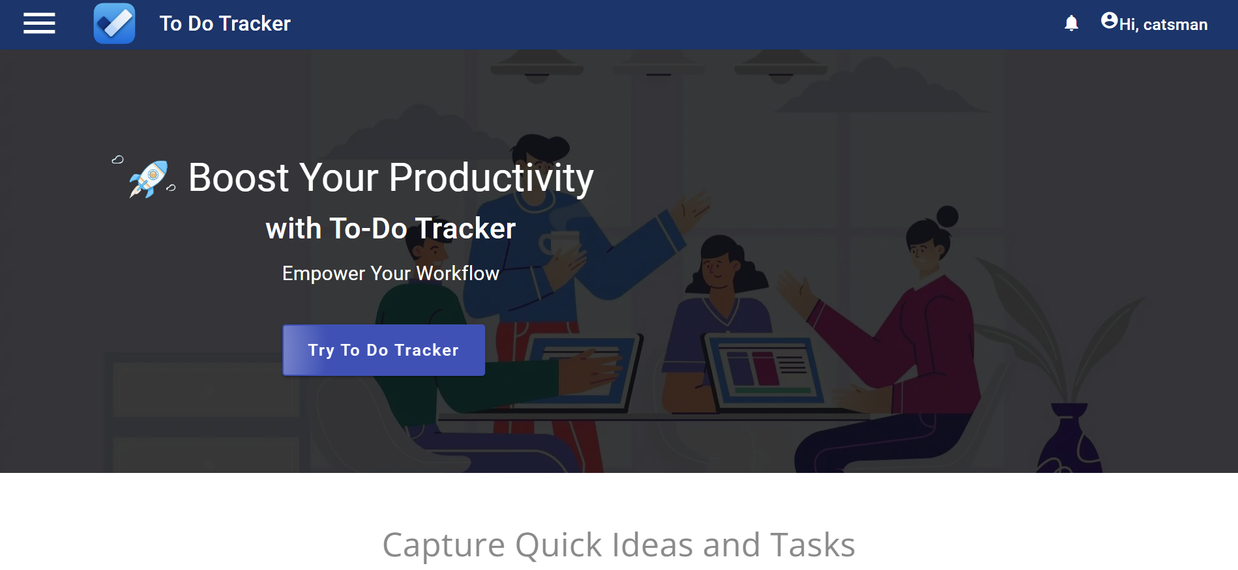
To Do Tracker

Slide 2



Team Members
Annanya Awasthi
Rupa Rani Thathari
Shalin Patekar
BTech (CSE)
BE (ECE)
BE (ME)

Slide 3
Introduction
In today's fast-paced world, staying organized and on top of our tasks can feel overwhelming. Whether you're a working professional managing various projects or a busy parent juggling household tasks, staying organized is crucial. Imagine a week filled with deadlines, meetings, and errands.
With the To-Do Tracker, you can effortlessly create task lists, categorize priorities, and ensure you stay on top of everything. It's like having a personal assistant to keep you focused and productive throughout your day.

Slide 4
To Do Tracker Features –
Efficient Task Creation: Streamline task management by easily adding new tasks with minimal effort.
Task Organization: Easily categorize tasks as work or personal for better organization.
Priority Filtering: Quickly identify and focus on tasks by filtering based on priority levels: low, medium, high, or urgent.
Update and Edit Tasks: Easily modify and edit tasks as needed to keep your to-do list accurate and up-to-date.
User-Friendly Interface: Enjoy a simple and intuitive interface designed for seamless task management.
Task Completion and Archiving: Keep your task list organized by marking completed tasks and archiving them for future reference.

Slide 5








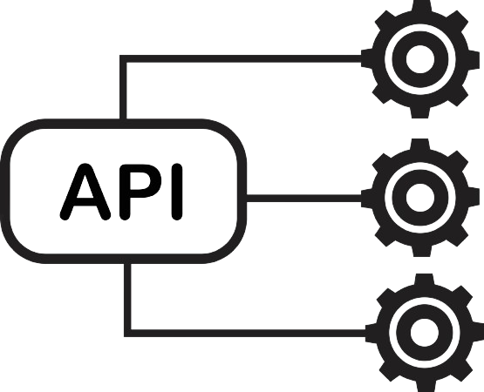

Technologies Used
Feign Client
API Gateway

Slide 6


Database used

Slide 7
Architectural Diagram

Slide 8
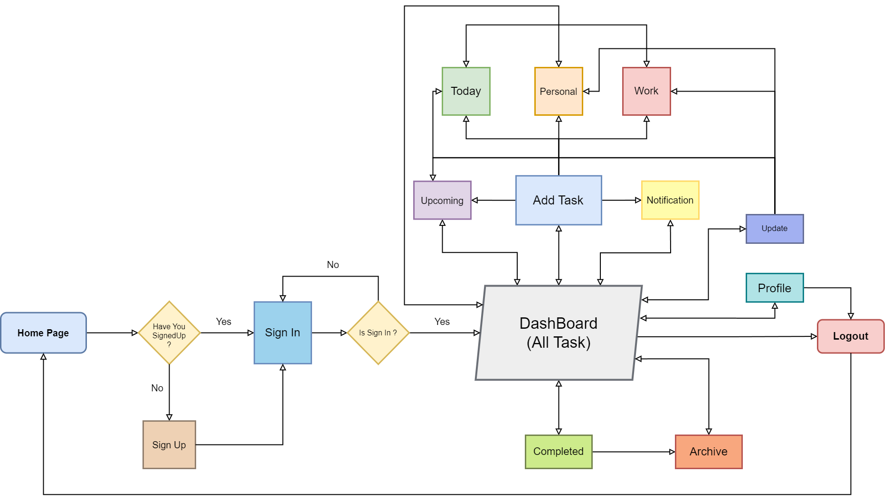
Work Flow Of To Do Tracker

Slide 9
Home Page

Slide 10
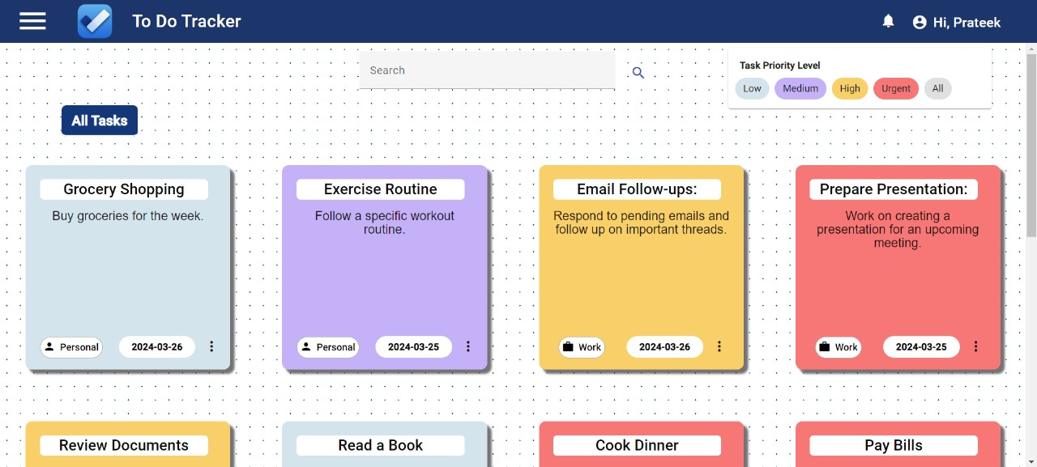
Dashboard

Slide 11
Future Enhancements -
Smart Suggestions: AI-driven task recommendations based on your habits.
Calendar Integration: Seamlessly sync tasks with popular calendar apps.
Collaboration: Share tasks and delegate responsibilities with team members.
Progress Tracking: Visual indicators for task completion status.
Advanced Reporting: Detailed analytics on task completion and productivity.
Custom Templates: Pre-designed or user-created templates for easy task organization.

Slide 12
Bibliography
Links –
Angular material UI
https://material.angular.io/components/categories
Spring Initializr
https://start.spring.io/
MVN Repository
https://mvnrepository.com/
Bootstrap 4
https://getbootstrap.com/docs/4.0/getting-started/introduction/
JWT
https://jwt.io/
W3schools
https://www.w3schools.com/howto/howto_css_parallax.asp

Slide 13



Slide 14
Thank you
Thank you for your time and consideration in evaluating our project. Your insights and guidance are truly appreciated.

